Slide 1
Singleton Pattern

Slide 2
A Pattern Taxonomy
Pattern
Creational
Pattern
Structural
Pattern
Behavioral
Pattern
Singleton
Factory
Singleton
Command
Observer
Strategy
Adapter
Bridge
Facade
Proxy

Slide 3
Singleton Pattern: Problem Statement
Ensure that a class has at most one instance.
Provide a global access point for it.

Slide 4
Singleton: Example 1
Problem: A single object should maintain a gaming application’s configuration.
Many objects may wish to read and update the configuration:
  How to restrict to only one instantiation?
  A singleton class will ensure that all the application’s objects get the same copy of the game’s configuration…

Slide 5
Singleton: Example 2
Problem: How to control access to resources such as database connections or sockets?
Example: You have a license for only one connection for your database:
  A Singleton makes sure that only one connection is made.
  If you buy more licenses or use a JDBC driver that allows multithreading, the Singleton can be easily adjusted to allow more connections.

Slide 6
Singleton: Example 3
Problem: Suppose you need a counter that gives out unique numbers (e.g. token numbers in a restaurant):
  First, the counter object needs to be unique.
  A Singleton counter can generate the numbers and synchronize access.

Slide 7
More Singleton Examples
One session manager per user session
One file system
One shopping basket per customer
One logger
One configuration object
One account per user,
Abstract factory and factory method, etc.

Slide 8
Singleton Pattern: Context
A Singleton is accessed by many objects in an application:
  Therefore should be easily and globally accessible --- Need a global point of access to the object.
  Ensure that only one instance of a class is created ---Allow multiple instances when required.

Slide 9
Singleton Solution: Main Idea
Create an object with operation:
  getInstance()
When the class is first accessed:
  Singleton instance is created and the object’s identity is returned.
On subsequent calls to getInstance():
  No new instance is created,
  Id of existing object is returned.

Slide 10
The Singleton Pattern
A Singleton class itself is responsible for keeping track of its sole instance.
  How? --- intercept all requests to create new objects.
Singletons maintain a static reference to the sole singleton instance:
  Return a reference to that instance from a static instance() method.

Slide 11
Singleton Structure
Singleton
Object identifier for singleton
instance, class scope i.e. static
-uniqueInstance
-singletonData
Returns object identifier for
unique instance
+getInstance( )
+getSingletonData( )
+singletonOperation( )
-Singleton( )
Private constructor only accessible
via getInstance()
getInstance( ) {
if ( uniqueInstance == null )
{ uniqueInstance = new Singleton( ); }
return uniqueInstance;
}

Slide 12
:Client
Singleton
getInstance
:Instance Singleton
<<new>>
[instance has not been created]
instance
instance
Send messages to instance as appropriate

Slide 13
Singleton: Example Code
  Public Class Singleton {
  private static Singleton uniqueInstance = null;
  // Why is uniqueInstance static?
  private Singleton( ) { .. } // private constructor
  public static Singleton getInstance( ) {
  if (uniqueInstance == null)
  uniqueInstance = new Singleton();
  return uniqueInstance;
  }
  }

Slide 14
Exercise 1
In a certain application:
  Objects first get a Database Manager: DBMgr.getDBMgr();
Need to ensure that:
  There is only one Database Manager object.
  Need to disallow creation of more than one object of this class.

Slide 15
Exercise 1: Solution
class DBMgr {
private static DBMgr pMgr=null;
Private DBMgr() { } // No way to create outside of this Class
public static DBMgr getDBMgr() { // Only way to create.
if (pMgr == NULL) pMgr = new DBMgr();
return pMgr; }
public Connection getConnection(); }
}
Usage:
DBMgr dbmgr = DBMgr.getDBMgr();
//Created first time called

Slide 16
Exercise 1: Random Number Generator
  public class RandomGenerator {
  private static RandomGenerator gen = new RandomGenerator();
  public static RandomGenerator getInstance() {
  return gen;
  }
  private RandomGenerator() {}
  public double nextNumber() {
  return Math.random();
  }
  }
Fill Code Here…
Any noticeable problem?
  Always creates the instance, even if it isn't used…

Slide 17
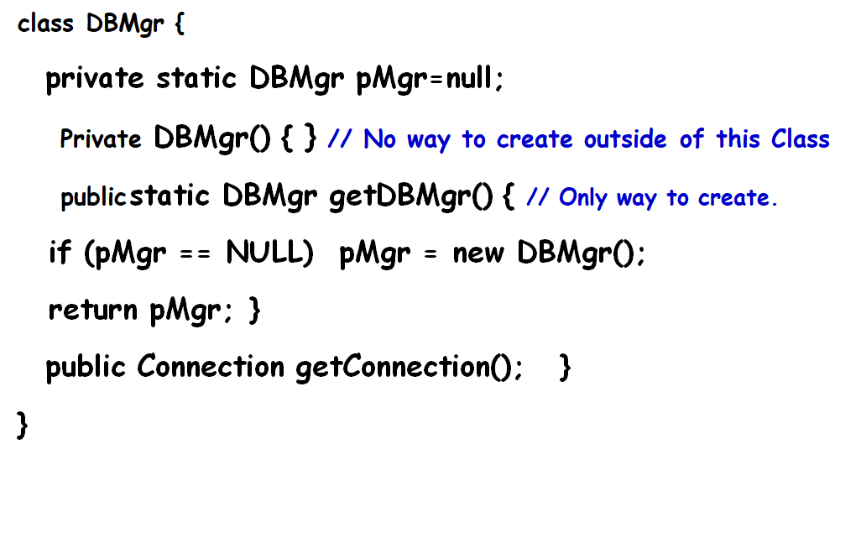
Singleton Pattern: Some Insights
Singleton with lazy instantiation:
  The singleton instance is not created until the instance() method is called for the first time.
  Ensures that singleton instance is created only when needed.
rotected constructor can be called by subclasses.

Slide 18
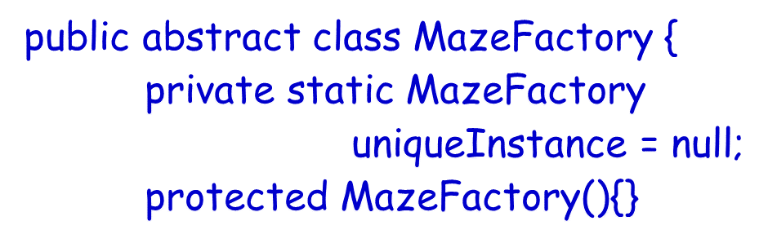
Singleton Pattern: Some Insights
Singleton subclassing: Singleton needs to implement a protected constructor:
  Clients cannot directly instantiate Singleton instances through call to new().
  But, subclasses can.
rotected constructor can be called by subclasses.

Slide 19
Multiple Singletons?
In certain situations, two or more Singletons can mysteriously materialize:
  Disrupting the very guarantees that the Singleton is meant to provide.
Consider a web application being executed in a browser.
  Each servlet uses its own class loader.
  In this case, static blocks are executed during the loading of class and even before the constructor is called.

Slide 20
Concurrent Executions…
// error as no synchronization on method
public static MySingleton getInstance() {
if (instance==null) {
instance = new MySingleton(); }
return instance;
}

Slide 21
Concurrency
// Correct solution
public static synchronized
MySingleton getInstance(){
if (instance==null) {
instance = new MySingleton(); }
return instance;
}

Slide 22
Solve concurrency issue without unnecessary locking
synchronized (RGen.class) is used here to make sure that there is exactly one Thread in the block..
public class RandomGenerator {
private static RandomGenerator gen = null;
public static RandomGenerator getInstance() {
if (gen == null) {
synchronized (RandomGenerator.class) {
// must test again -- can you see why?
if (gen == null)
gen = new RandomGenerator(); }
}
return gen;
}
}

Slide 23
Singleton Pattern: Variations
Multiton:
  We can easily change a Singleton to allow a small number of instances where this is allowable and meaningful.
  Operation that grants access to the Singleton instance needs to change.

Slide 24
final class Multiton{
private static final int COUNT = 10; // change to vary the number of instances
private static final Multiton[] INSTANCES = new Multiton[COUNT];
private static int index = 0;
static {
for (int i = 0; i < INSTANCES.length; i++) {
INSTANCES[i] = new Multiton();
}
}
private Multiton() {}
public synchronized Multiton getInstance(){
Multiton result = INSTANCES[index];
index = (index + 1) % INSTANCES.length;
return result;
}
}
Simple Multiton

Slide 25
Usage of Singleton in Other Patterns
Several patterns use Singleton Pattern for implementation.
  For instance AbstractFactory needs a singleton object for maintaining a single instance of the factory.

Slide 26
State Pattern

Slide 27

Introduction
An object is behaving differently when same method called twice. What could be the reason?
  Possibly the object has transited to a different state.
Example: Consider the responses to the “renew” request for the same book:
    Successfully renewed
    Reserved, cannot be renewed
    Book needed for stock taking, cannot be renewed
    Already renewed five times, cannot be renewed …

Slide 28





State of an Object
One or more attributes of a class acts as state variables.
  Depending on the values of the state variables.
    -- Some methods exhibit different behavior.
An example:
  A person may behave differently depending on his mood.

Slide 29



State Example: Person
mad
angry
happy
doWork()
doWork()
doWork()
doWork()
Work destructively
Work badly
Work properly

Slide 30
State Pattern: Overview
A Behavioral pattern.
Allows an object to alter its behavior when its state changes.
  The object will appear to change its class.
To realize different behavior for different states of an object.
  Polymorphism is used.

Slide 31
Typical State Behavior Implementation
Class Person {
Mood state;
doWork() {
if (state == angry)
doWorkBadly();
else if (state == happy)
doWorkProperly();
}
pleaseHelpMe() {
if (state == angry)
doScold();
else if (state == happy)
doHelp();
}
….
}
Many things you do depend on your state of mind

Slide 32
State Design Pattern
Idea: Value of an internal state variable determines Object behavior.
Intent:
  Allow an object to alter its behavior when value of its internal state variable changes.
  The object will appear to change its class.

Slide 33
State Pattern Basic Approach:
Replace Conditionals by Inheritance
abstract class A{
doWork();
}
doWork() {
If (condition)
doWorkProperly()
else
doWorkBadly();
}
****IfCondition****
doWork(){ doWorkProperly();}
****ElseCondition****
doWork(){ doWorkBadly();}

Slide 34

Example: State Pattern Structure
Mood
Person
state
variable
doWork()
doWork()
mad
angry
happy
doWork()
doWork()
doWork()

Slide 35
State Pattern: Working
Client
{ targetState.handleRequest(); }
Target
doRequest()
TargetState
handleRequest()
targetState
1
TargetStateA
handleRequest()
TargetStateB
handleRequest()
. . . . . .

Slide 36
How is State pattern implemented?
Context class:
  It is the class which changes state.
  Context class maintains a reference to the current state object.
  To change the state,
    The reference object needs to be changed.
Abstract State class
Derived classes:
  Define the changed behavior in states.
Context
AbsState
state variable
request()
handle()
Concrete State 1
Concrete State 2
Concrete State 3
handle()
handle()
handle()

Slide 37
State Pattern Structure
Context
AbsState
state variable
handle()
request()
Concrete State 1
Concrete State 2
Concrete State 3
Client
request()
handle()
handle()
handle()
Allow an object to alter its behavior (dynamically bind to a different method) when its internal state changes.

Slide 38
Example 1: Based on the current tool selection, the behavior of mouse press, key board press, etc. vary…
DrawingController
MousePressed() ProcessKeyboard() Initialize()
Tool
HandleMousePressed() HandleProcessKeyboard() GetCurser() Activate()
currentTool
Creation Tool
Selection Tool
Text Tool

Slide 39
Example 2: Behavior of H₂O Depends on Its State
H₂O
<<Abstract>>
H₂OState
H2OState s
increaseTemp()
decreaseTemp()
increaseTemp()
decreaseTemp()
Vapor
Water
Ice
Client
increaseTemp()
decreaseTemp()
increaseTemp()
decreaseTemp()
increaseTemp()
decreaseTemp()

Slide 40
Why Use A State Pattern?
The state pattern creates a separate class for each conditional branch.
  This eliminates if/else or switch/case statements.
Code is modular:
  Allows to easily change state behavior.

Slide 41
Exercise 0
A TCP connection may be in any of the following states:
  Connection established
  Listen
  Close
Methods open, close, and ack, behave differently in these states

Slide 42
State Pattern Example 3
state
TCPState
Open()
Close()
Acknowledge()
TCPConnection
Open()
Close()
Acknowledge()
State.Open()
TCPEstablished
Open()
Close()
Acknowledge()
TCPListen
Open()
Close()
Acknowledge()
TCPClosed
Open()
Close()
Acknowledge()
A TCPConnection object responds differently to requests for its different states.
All state-dependent actions are delegated.

Slide 43
Trade-offs
Advantages
Encapsulates behavior of a state into an object
Eliminates massive lines of code involving if/else or switch/case statements with state transition logic
State changes occur using one object, therefore avoids inconsistent states.
Disadvantages
Increased number of objects.

Slide 44
Exercise 1
Consider the following behavior of a class. --- Use state pattern to design the class diagram and write Java code to implement your design
A person may be good, bad, or ordinary:
  When asked to give money, a good person gives all his money, a bad person says he does not have any money, an ordinary person says he would give money later. A good person becomes bad, if he befriends a bad person. A bad person becomes a good, if he befriends a good person.

Slide 45
Exercise Solution- Class Diagram
Person
<<interface>>
Character
state variable
giveMeMoney()
befriend(person)
GoodCharacter
BadCharacter
Client
giveMeMoney()
giveMeMoney()
befriend(person)
giveMeMoney()
befriend(person)

Slide 46
Example Java Code [Without Pattern]
public class Person {
private String name;
private String character;
public Person(String name, String character){
this.name = name; this.character = character; }
public void giveMeMoney(){
if (character.equals("GoodCharacter")){ System.out.println("Yes, take all my money"); }
else if (character.equals("BadCharacter")){ System.out.println("No, I don’t have anything with me"); }
else if (character.equals("OtherCharacter")){ System.out.println("I will give the money tomorrow"); }
} }

Slide 47
Example Java Code [With Pattern]
public interface Character {
public void giveMeMoney(); }
public class GoodCharacter implements Character {
public void giveMeMoney() { System.out.println("Yes, take all my money"); } }
public class BadCharacter implements Character{
public void giveMeMoney() { System.out.println("No, I dont have anything with me"); } }

Slide 48
Example Java Code [With Pattern]
public class PersonPatternSol{
private String name;
private Character character;
public PersonPatternSol(String name, Character character){
this.name = name; this.character = character; }
public void giveMeMoney(){ character.giveMeMoney(); }
public static void main(String[] args) {
PersonPatternSol object = new Person2("John", new GoodCharacter()); object.giveMeMoney(); object = new PersonPatternSol("John", new BadCharacter()); object.giveMeMoney(); }
}

Slide 49
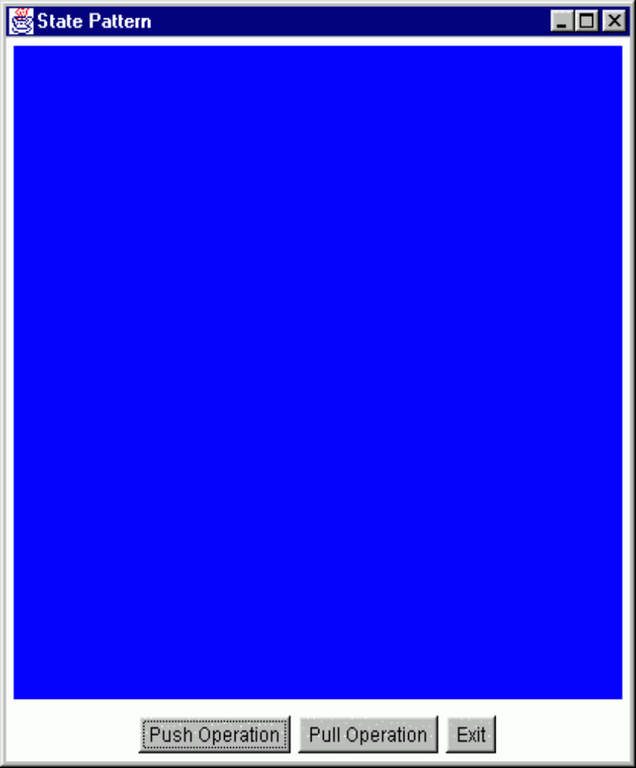
State Pattern Exercise 2: Color Changing Toy
Suppose there are 4 states:
  blue, black, green and red.
Two functions:
  push() and pull() changes the current state.
Blue state:
  push -> green state, pull -> red state
Black state:
  push -> red state, pull -> black state
Green state:
  push -> black state, pull -> blue state
Red state:
  push -> blue state, pull -> green state

Slide 50
State Exercise 2: Color Changing Toy
We have 4 states:
  blue, black, green and red.
Two functions:
  push() and pull() changes the current state.
Blue state:
  push -> green state, pull -> red state
Black state:
  push -> red state, pull -> black state
Green state:
  push -> black state, pull -> blue state
Red state:
  push -> blue state, pull -> green state

Slide 51
State Exercise 2: Color Changing Toy
We have 4 states:
  blue, black, green and red.
Two functions:
  push() and pull() changes the current state.
Blue state:
  push -> green state, pull -> red state
Black state:
  push -> red state, pull -> black state
Green state:
  push -> black state, pull -> blue state
Red state:
  push -> blue state, pull -> green state

Slide 52
Exercise 2: Solution
Toy
State
state variable
Push()
push()
Black State
Blue State
Red State
Green State
push()
Push()
Push()
Push()
Client
Allow an object to alter its behavior (dynamically bind to a different method) when its internal state changes.

Slide 53
Exercise 2: Solution
public abstract class State {
    public abstract void handlePush(Context c);
    public abstract void handlePull(Context c);
    public abstract Color getColor();
  }
public class BlackState extends State {
  public void handlePush(Context c) {
  c.setState(new RedState());}
  public void handlePull(Context c) {
  c.setState(new GreenState());}
  public Color getColor() {return (Color.black);}
  }

Slide 54
State Example Cont…
public class Context {
  private State state = null; // State attribute
  public Context(State state) {this.state = state;}
  public Context() {this(new BlueState());}
  public State getState() {return state;}
  public void setState(State state) {
  this.state = state;}
  public void push() {state.Push(this);}
}

Slide 55
Pros of State Pattern
Localizes state-specific behavior:
  Partitions behavior for different states into separate objects.
Makes state transitions explicit
  Obvious when moving from one state to another: as appropriate state class instance must be swapped in…

Slide 56
When are Concrete State Objects Created?
Two options:
  Created as and when they are needed.
  Create once, used whenever needed: Context class uses it when needed.

Slide 57
Food for thought…
Where to define the state transitions ?
  For simple cases, transition can be defined in the context.
  More usable if transition is specified in the State subclass.
Whether to create State objects as and when required or to create-them-once-and-use-many-times ?
  First one is desirable if state changes are infrequent.
  Later one is desirable if the state changes are frequent.

Slide 58
State Pattern: Final Analysis
Advantages
  Switch-case statement is not efficient. On the average, half of the options need to be examined.
  Code becomes modular:
    Otherwise states get handled in one place (switch-case):
    Otherwise any changes to state logic would need recompilation and retesting.

Slide 59
Known Uses and Related Patterns
Several interactive drawing programs use the State pattern.
The Flyweight pattern explains:
  When and how State objects can be shared.
State Objects are often Singletons.

Slide 60
Bonus Problems
How can nested states be handled?
How can AND states handled?
How can history state be handled?
Mail me your solution illustrated with suitable examples

